Slide 1
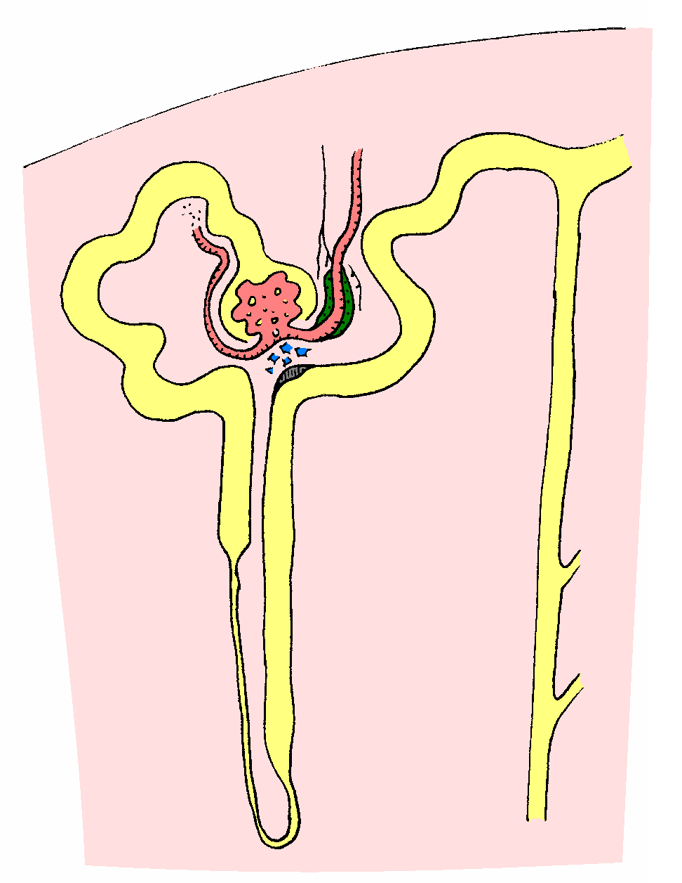
maintenance
HCl
1
generation
2
HCO₃
3
Cl replacement
resolution
4
bicarbonaturia
natriuresis
kaliuresis
Notes:
= volume depletion causes increased NHE3 activity
= low [Cl] at MD stimulates renin release (and hence aldo); aldo also directly stimulated by volume depletion
= lack of Cl inhibits Cl/HCO3 exchange by pendrin and hence stops HCO3 secretion by B-type Ics
= lack of Cl favours electrogenic Na exchange – hence H+ excretion and K+ excretion
…therefore paradoxical acid urine and kaliuresis

Slide 2
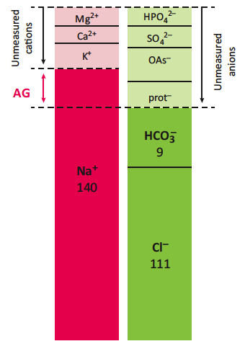
Case 3
OAs –
AG
prot –
normal
hypoalbuminaemia
Add on to the anion gap to correct for hypoalbuminaemia (Figge correction)

Slide 3
gluconate
glucose
pyruvate
lactate
acetate
acetyl-CoA
citrate
Kreb’s cycle
H⁺
= HCO₃ production
(1:1 molar ratio)
CO₂
Notes:
Plasmalyte-148 = 27 mM acetate + gluconate 23 mM= 50 mM HCO3 equivalents
Think of lactate etc. as ‘potential bicarbonate’ (Sabatini & Kurtzman, JASN 2008)
Lactate is metabolised predominantly by the liver (90%); acetate is metabolised by most tissues.

Slide 4
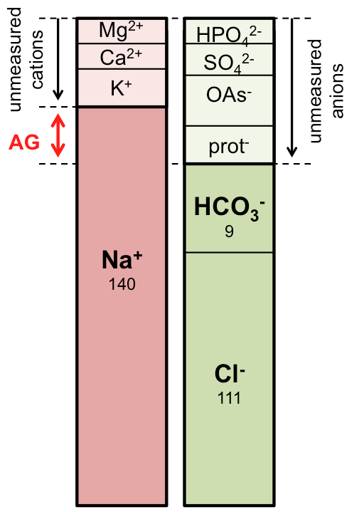
Sources of error…
unmeasured anions
albumin
unmeasured cations
IgG paraprotein
Ca²⁺, Mg²⁺, K⁺
Li⁺
pseudo-chloride
hyperlipidaemia
bromide, iodide, salycilate

Slide 5
correct AG for albumin
in a pure high AG acidosis…
ΔAG = ΔHCO₃
ΔAG / ΔHCO₃
<< 0.8 or >> 1.2 = mixed disorder
ΔΔ
- 5 or > +5 = mixed disorder

Slide 6
volume depletion
+ NHE3 in PCT
HCO₃ generated in gastric HCl production returned to circulation
low [Cl] at MD stimulates renin release
+ aldo
generation
maintenance
bicarbonaturia
resolution
bicarbonaturia
natriuresis
decreased pendrin activity in B-type ICs
ENaC generates lumen-negative potential
kaliuresis
paradoxical acid urine

Slide 7
sensor
signal transduction
set-point
+
–
+
effector mechanisms
+
[X]

Slide 8
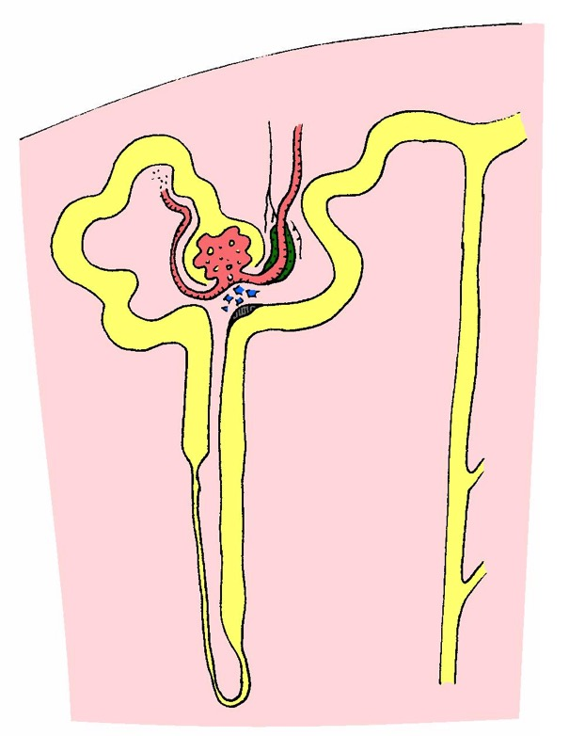

Slide 9
hypothalamus
ADH (AVP)
+
+
–
Renal free water excretion
+
GFR
diluting segment
ADH-responsive CDs
osmolar load
[Na⁺]
(tonicity)

Slide 10
“reset osmostat”
SIADH
drugs
cancer
chest disease
CNS disease
pain, stress
low EABV
heart failure, cirrhosis
UNa < 30 mOsm
hypovolaemia
D&V, third-spacing
hypothalamus
ADH (AVP)
thiazides
renal salt-wasting
adrenal insufficiency
(myxoedema)
+
+
UNa > 30 mOsm
–
Renal free water excretion
+
GFR
diluting segment
ADH-responsive CDs
osmolar load
[Na⁺]
(tonicity)
polydipsia
UOsm < 100 mOsm
low solute intake
beer potomania; “tea & toast”
Notes:
Low Na in CCF / cirrhosis = poor survival (Kim et al, NEJM 2008; Rusinaru et al, EJH 2012).

Slide 11
adrenal cortex
aldosterone
+
+
+
Cells
Renal potassium excretion
–
[K⁺]
GFR
tubular flow to distal nephron
K secretion (exchange for Na⁺)
insulin
catecholamines
acid-base
–
–
+
DCT (Kir4.1; Kir5.4)

Slide 12
adrenal insufficiency
heparin
adrenal cortex
aldosterone
ACEi
+
+
AKI
advanced CKD
+
Cells
Renal potassium excretion
–
[K⁺]
GFR
tubular flow to distal nephron
K secretion (exchange for Na⁺)
insulin
catecholamines
acid-base
–
rhabdomyolysis
tumour lysis
–
+
K-sparing diuretics
trimethoprim
CNIs
DCT (Kir4.1; Kir5.4)

Slide 13
parathyroid (CaSR)
PTH
+
–
+
+
1,25-OH vitD
Bone, gut, kidney
kidney (PCT)
mobilisation from bone stores
absorption from food
renal excretion
urine flow rate
+
[Ca²⁺]
+
–
+
renal tubule (CaSR)

Slide 14
hyperparathyroidism
primary / tertiary
cancer
PTHrP
parathyroid (CaSR)
PTH not low
PTH
+
PTH low
–
cancer
osteolytic lesions
myeloma
FHH
vitD ingestion
lymphoma
sarcoidosis / TB
+
+
1,25-OH vitD
Bone, gut, kidney
kidney (PCT)
mobilisation from bone stores
absorption from food
renal excretion
urine flow rate
+
[Ca²⁺]
milk-alkali
immobilisation
thyrotoxicosis
PTH low
(less common)

Slide 15
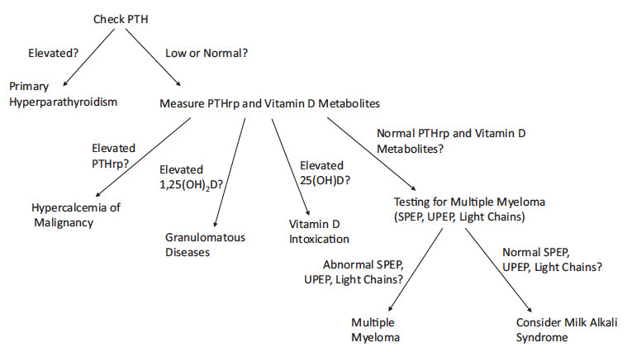
Bernstein (AJKD, 2019)

Slide 16
6
5
4
3
2
1
0
filtered
threshold
reabsorbed
T_{m}
HCO₃– flux / mmol per min
excreted
0 10 20 30 40 50
plasma [HCO₃–] / mM

Slide 17
normal
4.5
5.0
5.5
6.0
6.5
7.0
7.5
8.0
pRTA
urine pH
dRTA
12 16 20 24 28 32 36
reabsorbed
pRTA = down-shifted Tm
HCO₃– flux
pRTA
HCO₃ in distal tubular fluid consumes secreted H⁺
filtered
normal
(& dRTA)
excreted
12 16 20 24 28 32 36
serum [HCO₃–] / mM
pRTA = left-shifted threshold

